Slide 1
Digital Portfolio
STUDENT NAME:S.Thamaraiselvi
REGISTER NO AND NMID: 2428B0251
,6F9CA2E0B60A43B883545BF1477E7C5
DEPARTMENT: BSC computer science with data analytics
COLLEGE: COLLEGE/ UNIVERSITY Tiruppur KUMARAN COLLEGE FOR WOMEN /BHARATHIYAR University

Slide 2
PROJECT TITLE
My digital portfolio

Slide 3


AGENDA
Problem Statement
Project Overview
End Users
Tools and Technologies
Portfolio design and Layout
Features and Functionality
Results and Screenshots
Conclusion
Github Link
3/21/2024 Annual Review

Slide 4

PROBLEM STATEMENT
Teachers usually share only resumes or certificates to show their qualifications. But these do not clearly show their teaching style, skills, or achievements. Because of this, schools and parents may not fully understand the teacher’s abilities.
A teacher Portfolio is needed to collect and present all
important details like education, subjects handled, achievements, teaching methods, and contact information in one place. This makes it easier to understand a teacher’s professional journey and strength

Slide 5

PROJECT OVERVIEW
The Teacher Portfolio project is designed to create a single platform where teachers can present their qualifications, teaching experience, subjects, achievements, and skills in an organized way.
It works like a digital profile that highlights the teacher’s professional journey and makes it
easy for schools, students, and parents to know more about them. The portfolio includes sections such as About Me, Subjects, Experience, Achievements, and Contact.
This project aims to make teacher information clear, professional, and easy to access

Slide 6

WHO ARE THE END USERS?
Teachers – to showcase their skills, achievements, and experience.
Schools/Institutions – to easily evaluate and select teachers.
Students – to know about their teacher’s background and subjects.
Parents – to understand the teacher’s qualifications and teaching style.

Slide 7

TOOLS AND TECHNIQUES
HTML, CSS, JavaScript – for designing and building the portfolio website.
Web Hosting Platforms (GitHub Pages / Neatly) – to publish the portfolio online.
Design Tools (Canvas / Figment) – to create visuals, icons, and layout ideas.
Word Processors (MS Word / Google Docs) – for preparing content before adding.
Browsers (Chrome, Edge) – for testing and viewing the portfolio.

Slide 8
POTFOLIO DESIGN AND LAYOUT
Header / Introduction
Teacher’s name, photo (or initials), and designation.
Short tagline (e.g., “Passionate Mathematics Teacher”).
About Me
Brief introduction, education, and teaching philosophy.
Subjects & Skills
Subjects handled and key teaching skills shown as a list or tags.
Experience
Work history with school names, years, and responsibilities.
Achievements
Awards, certifications, and special recognitions.
Contact Section
Email, phone number, and social media links.
Layout Style
Simple, clean design with sections arranged top to bottom.
Use of cards, grids, or columns for neat presentation.
Consistent fonts and light background for readability.

Slide 9
FEATURES AND FUNCTIONALITY
Profile Section – shows teacher’s name,
photo, and designation.
About Me – short introduction, education, and teaching style.
Subjects & Skills – list of subjects handled and special skills.
Experience – details of past and current
teaching work.
Achievements – awards, certifications, and recognitions.
Download Resume – option to download
teacher’s CV.
Contact Form – students/parents/schools can send messages.
Responsive Design – works on mobile, tablet, and computer.

Slide 10
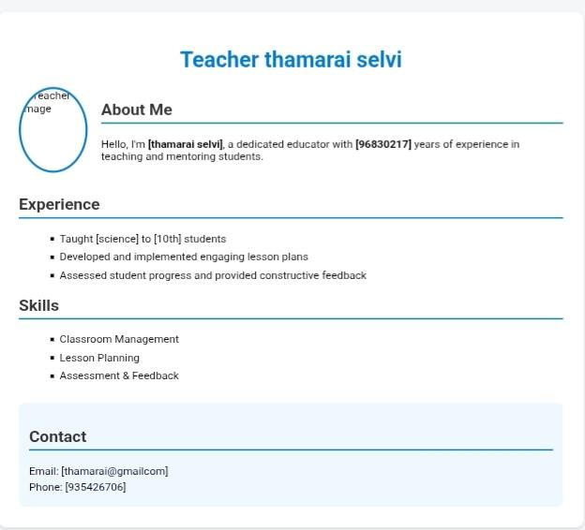

RESULTS AND SCREENSHOTS
3/21/2024 Annual Review

Slide 11
CONCLUSION
A Teacher Portfolio shows all the important details of a teacher in one place. It helps teachers present their skills and achievements clearly, and makes it easy for schools, students, and parents to know about the teacher.

